Slide 1







Chapter 1
THE HISTORIAN
the historian
Strand One: The Nature of History
@MsDoorley

Slide 2
Learning Outcomes
1.4 DEMONSTRATE awareness of historical concepts such as source and evidence; fact and opinion; viewpoint and objectivity; cause and consequence; change and continuity; time and space
1.5 INVESTIGATE the job of the historian, including how they find and use evidence to form historical judgements which maybe revised and reinterpreted in the light of new evidence
1.6 DEBATE the usefulness and limitations of different types of primary and secondary sources of historical evidence, such as written, visual, aural, oral and tactile evidence; and APPRECIATE the contribution of archaeology and new technology to historical enquiry.
1.7 DEVELOP historical judgements based on evidence such as a museum, library, heritage centre, digital or other archive exhibition
1.10 DEMONSTRATE chronological awareness by creating and maintaining timelines to locate personalities, issues and events in their appropriate historical eras.
Strand One: The Nature of History
Chapter One: The Historian
@MsDoorley

Slide 3
Introduction
Before we begin to learn about different events and people in the past, it is important to learn about what history is and why we study history. Historians and archaeologists are some of the people involved in the study of history. They often work together and both are essential to our understanding of the past. In this chapter, we will learn about the historian and the work that they do.
Strand One: The Nature of History
Chapter One: The Historian
@MsDoorley

Slide 4
Chapter 1
1.1: WHAT IS HISTORY?
1.1: What is History?
Strand One: The Nature of History
@MsDoorley

Slide 5
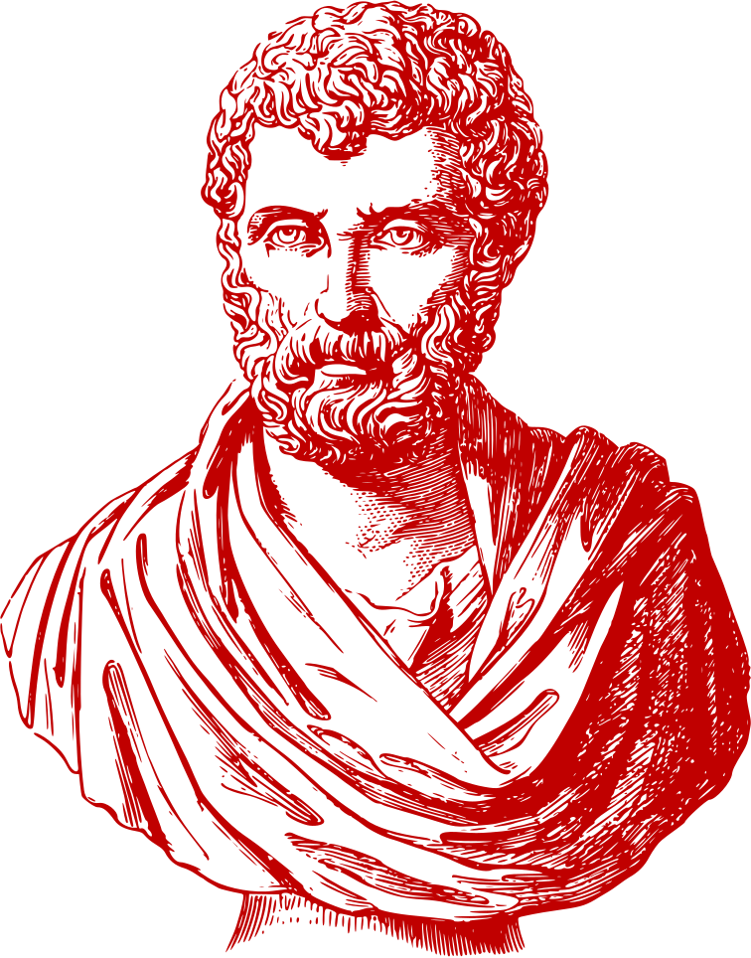

History
History is the study of the past. It is based on evidence and the study of sources.
A source is something that gives us information or evidence about a person, place or thing in the past.
History focuses on the study of human activity – it is the story of the past; and continues right up to this day! When we study history, we often learn about major events from the past.
However, we don’t just look at the lives of important people but also the everyday lives of ordinary people. We learn about their jobs, their clothing, where they lived and what they did for entertainment.
When studying history, we investigate not only what happened but why it happened.
Strand One: The Nature of History
Chapter One: The Historian
Did you know?
Herodotus was a Greek writer from the fifth century BC. He is known as 'the father of history'. He wrote The Histories, which is regarded as the first work of history. Herodotus used various sources to describe military conflicts between the Persians and the Greeks
@MsDoorley

Slide 6
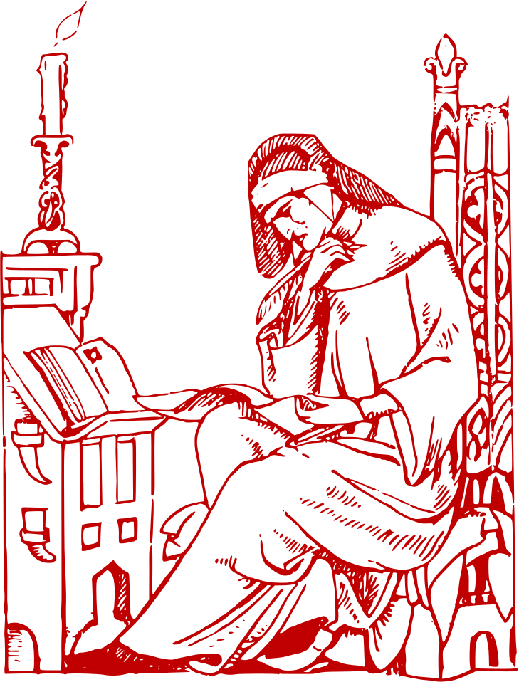


Prehistory v History
We use the word prehistory to speak about the period of time before writing was used: we rely on archaeology (the study of the remains left by people in the past) for evidence from this time.
An example of a prehistoric source might be a weapon made by people to hunt for food.
We use the word history when we are speaking about everything that has happened since people began to use writing.
An example of a written source might be the Annals of the Four Masters, an account of Irish history written by Irish monks.
Strand One: The Nature of History
Chapter One: The Historian
@MsDoorley

Slide 7
Checkpoint Questions (pg. 1, Artefact 2nd Edition)
Explain the terms history and prehistory.
Where does the word history come from?
Explain the term source.
Give two examples of a source.
Explain the term archaeology.
Strand One: The Nature of History
Chapter One: The Historian
@MsDoorley

Slide 8
Checkpoint Questions (pg. 1, Artefact 2nd Edition)
History: the study of the past; Prehistory: the period of time before writing was used.
History comes from the Greek word historia, meaning ‘knowledge from investigation’.
Source: something that gives us information or evidence about a person, place or thing in the past.
Any two of: clothes, coins, pottery, weapons, remains of buildings, documents.
Archaeology: the study of the remains left by people in the past.
Strand One: The Nature of History
Chapter One: The Historian
@MsDoorley

Slide 9
Chapter 1
1.2: THE STUDY OF HISTORY
1.2: The Study of History
Strand One: The Nature of History
@MsDoorley

Slide 10
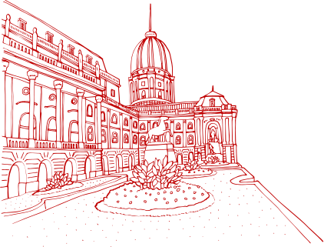
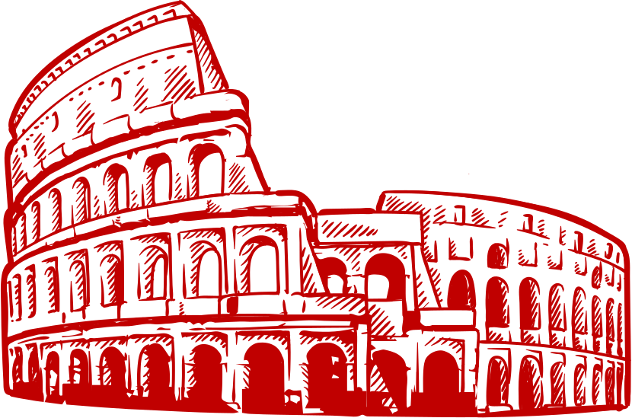
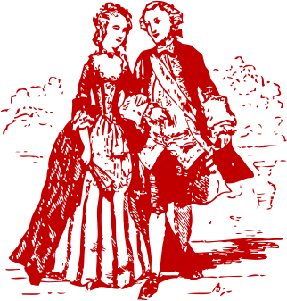
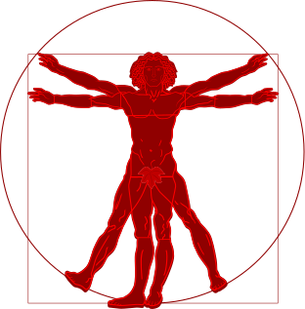
Why we study history
Through the study of history, we can:
learn how people lived before us
gain an understanding of the causes and effects of past events
understand how human experience has shaped our world today
learn to recognise patterns of change
All of this has an impact on us in the present day, helping us to see how we can avoid making the same mistakes that our ancestors made, and to be inspired and learn from their successes and achievements.
Through studying history, we can develop our historical consciousness which is being able to place ourselves in past human experience, linking the past, the present and the future.
Strand One: The Nature of History
Chapter One: The Historian
@MsDoorley

Slide 11
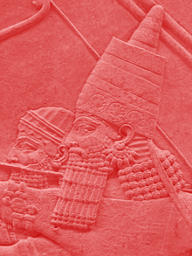
Who studies history?
Anybody can study history - as a student taking history for your Junior Cycle, you are a historian.
A historian is someone who is an expect, or a student of, history.
Historians gather evidence from a variety of sources to piece together information about the past - they are interested in the reasons why things happened and also in what the results were.
An archaeologist is someone who investigates places and objects left by people in the past, including the time before written records were kept.
Most of what we know about early history comes from archaeology.
Strand One: The Nature of History
Chapter One: The Historian
"Those who do not remember the past are condemned to repeat it."
George Santayana, Spanish-American philosopher (1863-1952)
@MsDoorley

Slide 12
Checkpoint Questions (pg. 2, Artefact 2nd Edition)
List three reasons why we study history.
Explain the term historical consciousness.
Explain the terms historian and archaeologist.
Name three groups of people who study history.
Strand One: The Nature of History
Chapter One: The Historian
@MsDoorley

Slide 13
Checkpoint Questions (pg. 2, Artefact 2nd Edition)
Any three of: to learn how people lived before us, to gain an understanding of the causes and effects of past events, to understand how human experience has shaped our world today, to learn to recognise patterns of change, to avoid the mistakes that our ancestors made, and to learn from their successes, to be inspired by people in the past and appreciate their achievements.
Historical consciousness: being able to place ourselves in past human experience, linking the past, the present and the future.
Historian: someone who is an expert in, or a student of, history; Archaeologist: someone who investigates places and objects left by people in the past, including the time before written records were kept.
Students in schools, historians and archaeologists.
Strand One: The Nature of History
Chapter One: The Historian
@MsDoorley

Slide 14
Chapter 1
1.3: THE JOB OF THE HISTORIAN
1.3: The Job of the Historian
Strand One: The Nature of History
@MsDoorley

Slide 15
Finding Evidence
Historians need to gather as much evidence as possible from different sources which means they can cross-check (when more than one source is used to make sure the information is correct) the information they find.
A historical repository is a place where evidence of the past can be stored and maintained, for example artefacts, government documents, manuscripts or photographs.
A historian may go to the historical repositories such as libraries, archives and museums to find evidence.
An archive is a place that catalogues and stores a collection of written and other sources. The National Archives of Ireland in Dublin holds the records of the Irish State.
A library is a building or room containing collections of books, periodicals, and sometimes films and recorded music for use or borrowing by the public or the members of an institution. Trinity College Library is home to the Book of Kells.
A museum is a place that collects and displays objects for public education and appreciation. The National Museum in Dublin has Bronze Age Irish metalwork, Viking artefacts and treasures from Ancient Egypt on display.
A heritage centre is a type of museum that stores, preserves and displays important objects relating to the history and culture of its local area. Cobh Heritage Centre contains sources of information about people leaving Ireland during the Great Famine.
Strand One: The Nature of History
Chapter One: The Historian
@MsDoorley

Slide 16
Evaluating Historical Repositories
The WORTH IT strategy will help you, to assess whether the repositories you visit, online or in person, are good sources of information.
Worthwhile: Does it offer something unique, e.g. an experience you can't get elsewhere?
Open to all: Is it easy to access and suitable to different audiences?
Range of sources: Are there other artefacts and evidence you can view?
Thorough: Does it tell the full story?
Historically accurate: Is the information accurate and balanced?
Interesting: Did you enjoy your visit?
Tactful: If it deals with a sensitive topic, does it do this well?
Strand One: The Nature of History
Chapter One: The Historian
@MsDoorley

Slide 17
Sources used by Historians
Historians use many types of source for information or evidence, which can be split into two categories:
A primary source is a source from the time in question; a first-hand account of what happened.
A secondary source is a source from a later date, after the time in question.
Examples of Primary Sources | Examples of Primary Sources | Examples of Secondary Sources
Artefacts Diaries Letters Emails Interviews Speeches Posters | Photographs Cartoons and drawings Government records, e.g. a census Newspapers Magazines Autobiographies Maps | TV/Film and Radio Documentaries Podcasts Websites History Books and Textbooks Biographies Handling Boxes Movies
Strand One: The Nature of History
Chapter One: The Historian
An artefact is any human-made object, e.g. pottery, a tool or a weapon such as a spear.
A census is an official survey of a population - in Ireland, a census is held every five years.
An autobiography is an account of a person's life written by the person themselves.
A biography is an account of a person's life written by someone else.
A handling box is a box containing replicas (copies) of artefacts, so that anyone can examine them without damaging an original.
@MsDoorley

Slide 18
Checkpoint Questions (pg. 5, Artefact 2nd Edition)
Explain the term historical repository.
List three places a historian can find evidence.
Explain the terms cross-checking and artefact.
Explain the terms primary source and secondary source.
List three examples of primary sources and three examples of secondary sources.
List two examples of written sources.
Strand One: The Nature of History
Chapter One: The Historian
@MsDoorley

Slide 19
Checkpoint Questions (pg. 5, Artefact 2nd Edition)
Historical repository: a place where evidence of the past can be stored and maintained, for example artefacts, government documents, manuscripts or photographs.
Any three of: libraries, archives, museums, the internet.
Cross-checking: when more than one source is used to make sure the information is correct; Artefact: any human- made object, e.g. pottery, a tool or a weapon, such as a spear.
Primary source: a source from the time in question; a first-hand account of what happened; Secondary source: a source from a later date, after the time in question.
Primary sources: any three of: artefacts, diaries, letters, emails, interviews, speeches, posters, photographs, cartoons and drawings, government records, newspapers, magazines, autobiographies, maps; Secondary sources: any three of: TV/film and radio documentaries, podcasts, websites, history books and textbooks, biographies, handling boxes, movies.
Any two of: diaries, letters, emails, government records, autobiographies, newspapers, magazines, history books and textbooks, biographies.
Strand One: The Nature of History
Chapter One: The Historian
@MsDoorley

Slide 20
Chapter 1
1.4: WORKING WITH SOURCES
1.4: Working with Sources
Strand One: The Nature of History
@MsDoorley

Slide 21

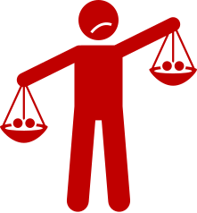
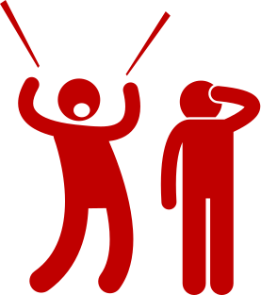


Reliability of Sources
Historians must be careful of a number of things when using sources, making sure that they are reliable while also examining the point of view of the person behind the source.
To do this, they must be aware of the following:
Accuracy involves judging how correct is the information you are using.
Bias is when an account is not balanced, and unfairly favours one side.
Exaggeration is when something is represented as better or worse than it actually was.
Propaganda is information that has been designed to influence the attitudes and behaviours of the general public.
Strand One: The Nature of History
Chapter One: The Historian
@MsDoorley

Slide 22
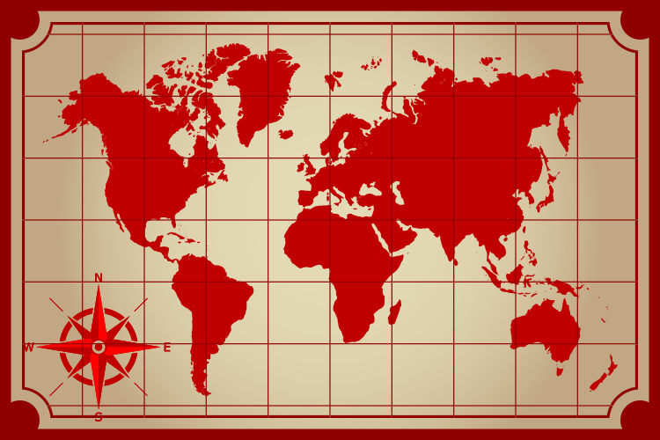



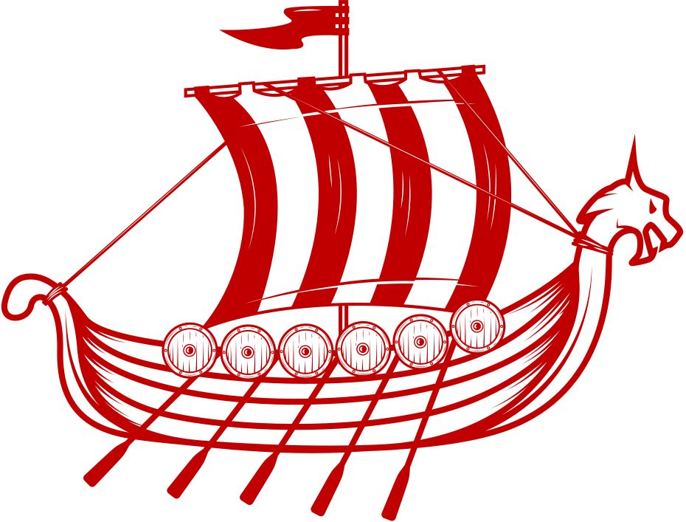
Types of Sources
Sources can be categorised into five different types:
Written – is a written document from the time.
Visual – what we can see.
Aural – what we can hear.
Oral – what we can discuss.
Tactile – a source that can be touched.
Generally, primary sources tell us more clearly what life was like at the time.
Secondary sources give us background information to aid what we learn from the primary source.
Strand One: The Nature of History
Chapter One: The Historian
@MsDoorley

Slide 23
Checkpoint Questions (pg. 6, Artefact 2nd Edition)
Explain the terms bias and propaganda.
Name three things historians need to consider when studying sources.
Explain the term tactile source.
We must be cautious about accepting secondary sources as fact. Discuss the list of secondary sources below with your group and decide which source you think is the most reliable and which source is the least reliable. Give reasons for your answers.
Strand One: The Nature of History
Chapter One: The Historian
@MsDoorley

Slide 24
Checkpoint Questions (pg. 6, Artefact 2nd Edition)
Bias: when an account is not balanced, but unfairly favours one side. Sometimes a person may be unaware that their interpretation is not a fair one, sometimes it is deliberate, to influence others; Propaganda: information that has been designed to influence the attitudes and behaviours of the general public. It is generally biased, often appeals to the emotions (fear, anger, loyalty) and may even be made up.
The reliability of the source, examine the point of view of the person behind the source, be aware of issues of accuracy, bias, exaggeration and propaganda.
Tactile source: a source that can be touched, a physical objectlike an artefact (tools, weapons, clothing, furniture, buildings, etc.), handling boxes.
Any source that the students think is the most reliable and any source that the students think is the least reliable, with reasons given in justification for their answers.
Strand One: The Nature of History
Chapter One: The Historian
@MsDoorley

Slide 25
Chapter 1
1.5: TIME AND TIMELINES
1.5: Time and Timelines
Strand One: The Nature of History
@MsDoorley

Slide 26

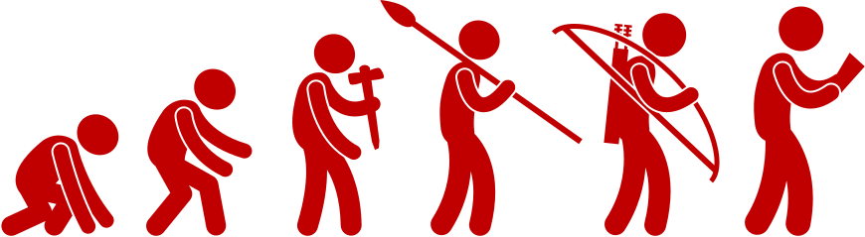
Time and Chronology
Timing and the order of events is very important to historians.
With new information about the past, historians put events into the sequence in which they happened (chronology), making it easier to follow the story of events.
To help with this, historians:
Divide time into hours, days, weeks, months and years.
Group years into decades (10 years), centuries (100 years), and millennia (1,000 years).
Organise events using a common feature from a period of time, e.g. the era when tools were made from stone is called the 'Stone Age' and was followed by the Bronze and Iron Ages.
Use timelines to show the order in which events happened.
Strand One: The Nature of History
Chapter One: The Historian
Did you know?
Some cultures use different calendar systems. For example, 2023 is the Islamic year 1444 (it uses a different starting point) and the Chinese Year of the Rabbit (it counts in cycles rather than in a straight line).
@MsDoorley

Slide 27
Timelines and Dates
In the Western World, the birth of Jesus Christ is used as a fixed starting point: we count all of time either forwards or backwards from this point.
We call any date before the birth of Jesus BCE (Before Common Era) or BC (Before Christ).
The first Olympic Games took place in 776 BCE/BC – 776 years before Jesus was born. The year 776 BC was in the eight century BC; beginning in 799 BC and ending in 700 BC – think of it like a countdown!
We call any date since the birth of Jesus either CE (Common Era) or AD (Anno Domini – ‘The Year of Our Lord’)
The twenty-first century (this century) began with the year AD 2000 and will end with the year 2099.
Strand One: The Nature of History
Chapter One: The Historian
BCE
CE
Century | Starts | Ends
6th Cen BC | 599 | 500
12th Cen BC | 1199 | 1100
20th Cen AD | 1900 | 1999
21st Cen AD | 2000 | 2099
BEFORE COMMON ERA
1
COMMON ERA
1500 BCE
1300
1100
900
700
500
300
100
100
300
500
700
900
1100
1300
1500 CE
PREHISTORY
NOW
1400
1200
1000
800
600
400
200
200
400
600
800
1000
1200
1400
BC
BIRTH OF CHRIST
AD
BEFORE CHRIST
ANNO DOMINI
@MsDoorley

Slide 28
Chapter 1
1.6: REINTERPRETING HISTORY
1.6: Reinterpreting History
Strand One: The Nature of History
@MsDoorley

Slide 29
Reinterpretation
Over time a new piece of evidence may emerge which may lead to an event or time in history being reinterpreted.
Reinterpretation means to see something in a new or different light.
New evidence sometimes creates doubt about what we believed to have happened during events and needs to be carefully studied.
One example is the sinking of the Titanic in 1912.
New evidence has revealed that a fire weakened the hull, making it easier for the iceberg to breach the metal.
Another example is the role of women in the War of Independence.
For decades, the role of women in the war was not widely recognised nor celebrated by people in the Irish State. However new evidence has uncovered the crucial role played by women in the struggle for Irish independence such as providing safe houses, distributing money, smuggling, and spying.
Strand One: The Nature of History
Chapter One: The Historian
@MsDoorley

Slide 30
Checkpoint Questions (pg. 8, Artefact 2nd Edition)
Explain the term chronology.
List three ways historians put events in order.
What centuries do these years belong to: (a) AD 1066; (b) 514 BC?
Which is earlier: 30 BC or 41 BC?
Explain the term reinterpretation.
Strand One: The Nature of History
Chapter One: The Historian
@MsDoorley

Slide 31
Checkpoint Questions (pg. 8, Artefact 2nd Edition)
Chronology: to put events into the sequence in which they happened.
Any three of: divide time into hours, days, weeks, months and years, group years into decades (10 years), centuries (100 years) and millennia (1,000 years), organise events using a common feature from a period of history, use timelines to show the order in which events happened.
(a) The eleventh century; (b) the sixth century.
41 BC.
Reinterpretation: to see something in a new or different light.
Strand One: The Nature of History
Chapter One: The Historian
@MsDoorley

Slide 32




Summary Poster Task
Imagine you are teaching a 5th and 6th Class group about the work of the Historian.
Using the page you have been given, create a poster in which you use visual (what you can see) and written (what you can read) information that you can use to tell the younger students about what you have learned about the work of the Historian.
You must have a title.
You may include information about:
Historical Repositories
Sources and Types of Sources
How a Historian researches
Timelines
Keywords
Strand One: The Nature of History
Chapter One: The Historian
@MsDoorley

Slide 33
Chapter 1
1.7: SUMMARY
1.7: summary
Strand One: The Nature of History
@MsDoorley

Slide 34
In this chapter, we have learned that:
History is the study of the past.
The time before writing was in use is called prehistory. We depend on archaeology for evidence about the prehistoric era.
Historians use historical repositories such as museums, libraries and archives to find evidence. They cross-check their sources.
Sources give us evidence about the past.
Sources can be primary or secondary, and can be further categorised into written, visual, oral, aural and tactile sources.
Historians must judge how reliable or accurate a source is by being aware of the possibility of bias, exaggeration and propaganda.
Historians put events into chronological order using hours, days, weeks and years. Years are often counted in decades (ten years), centuries (100 years) or millennia (1,000 years).
Historians make timelines and use BCE/BC and CE/AD when specifying years.
History must sometimes be reinterpreted when new evidence is discovered.
Strand One: The Nature of History
Chapter One: The Historian
@MsDoorley

Slide 35
Reflecting what we have learned...
The historian's work shows us the importance of enquiry, research and discovery in gathering information about the past. We recognise the important role of reliable evidence in enabling us to understand the past.
Strand One: The Nature of History
Chapter One: The Historian
@MsDoorley

Slide 36
SEC Examination Questions
2021 SEC Sample Q1
2022 SEC Q8a-d
2023 SEC Q1
Strand One: The Nature of History
Chapter One: The Historian
@MsDoorley

